Slide 1

Đề tài môn học các hệ thống phân tán
Xây dựng hệ thống DNS đơn giản
Giảng viên hướng dẫn: ThS. Huỳnh Trọng Thưa
Sinh viên thực hiện:
Nguyễn Thế Hào – N13DCCN044
Trần Mạnh Cầm – N13DCCN014
Huỳnh Tấn Hoàng – N13DCCN056
Trần Hoàng Phi Anh – N13DCCN003

Slide 2

I. Giới thiệu DNS
II. Xây dựng hệ thống DNS đơn giản
III. Hệ thống phân tán sử dụng DNS
IV. Hệ thống phân tán sử dụng RMI
V. Vitual IP ( Chưa hoàn thiện )
Notes:
Half-circle picture with accent arcs
(Basic)
To reproduce the shape effects on this slide, do the following:
On the Home tab, in the Slides group, click Layout, and then click Blank.
On the Home tab, in the Drawing group, click Shapes, and then under Basic Shapes, click Arc (third row, 12th option from the left). On the slide, drag to draw an arc.
Select the arc. Under Drawing Tools, on the Format tab, in the Size group, do the following:
In the Shape Height box, enter 7.5”.
In the Shape Width box, enter 7.5”.
Drag the right yellow diamond adjustment handle to the bottom of the slide to create a half-circle.
Under Drawing Tools, on the Format tab, in the bottom right corner of the Shape Styles group, click the Format Shape dialog box launcher. In the Format Shape dialog box, click Fill in the left pane. In the Fill pane, select Picture or texture fill, and then under Insert from, click File.
In the Insert Picture dialog box, select a picture, and then click Insert.
Also in the Format Shape dialog box, in the Fill pane, under Insert from, select Tile picture as texture.
Also in the Format Shape dialog box, click Line Color in the left pane, and then select No line in the Line Color pane.
Also in the Format Shape dialog box, click Shadow in the left pane, and then do the following in the Shadow pane:
Click the button next to Presets, and then under Inner click Inside Diagonal Top Right (first row, third option from the left).
In the Transparency box, enter 70%.
In the Blur box, enter 20 pt.
In the Distance box, enter 20 pt.
Drag the half-circle to the left until the two middle yellow adjustment diamonds are lined up with the left edge of the slide. On the Home tab, in the Drawing group, click Arrange, point to Align, and then do the following:
Click Align to Slide.
Click Align Middle.
Select the arc. On the Home tab, in the Clipboard group, click the arrow under Copy, and then click Duplicate.
Select the second arc. Under Drawing Tools, on the Format tab, in the Size group, do the following:
In the Shape Height box, enter 6.79”.
In the Shape Width box, enter 10.03”.
On the Home tab, in the bottom right corner of the Drawing group, click the Format Shape dialog box launcher. In the Format Picture dialog box, click Fill in the left pane, and then in the Fill pane, select No fill.
Also in the Format Shape dialog box, click Line Color in the left pane. In the Line Color pane, select Solid line and then do the following:
Click the button next to Color, and then under Theme Colors click White, Background 1 (first row, first option from the left).
In the Transparency box, enter 50%.
Also in the Format Shape dialog box, click Line Style in the left pane. In the Line Style pane, in the Width box, enter 1.5 pt.
Drag the second arc left on the slide until the two middle yellow adjustment diamonds are lined up with the left edge of the slide. On the Home tab, in the Drawing group, click Arrange, point to Align, and then do the following:
Click Align to Slide.
Click Align Middle.
Select the second arc. On the Home tab, in the Clipboard group, click the arrow under Copy, and then click Duplicate.
Select the third arc. Under Drawing Tools, on the Format tab, in the Size group, do the following:
In the Shape Height box, enter 6.86”.
In the Shape Width box, enter 9.98”.
On the Home tab, in the bottom right corner of the Drawing group, click the Format Shape dialog box launcher. In the Format Shape dialog box, click Line Color in the left pane, select Gradient line in the Line Color pane, and then do the following:
In the Type list, select Linear.
Click the button next to Direction, and then click Linear Down (first row, second option from the left).
Under Gradient stops, click Add gradient stop or Remove gradient stop until two stops appear in the slider.
Also under Gradient stops, customize the gradient stops that you added as follows:
Select the first stop in the slider, and then do the following:
In the Position box, enter 0%.
Click the button next to Color, and then under Theme Colors click Blue, Accent 1, Lighter 40% (fourth row, fifth option from the left).
In the Transparency box, enter 77%.
Select the second stop in the slider, and then do the following:
In the Position box, enter 100%.
Click the button next to Color, click More Colors, and then in the Colors dialog box, on the Custom tab, enter values for Red: 208, Green: 215, Blue: 222.
In the Format Shape dialog box, in the Line Style pane, in the Transparency box, enter 90%.
Also in the Format Shape dialog box, click Line Style in the left pane. In the Line Style pane, in the Width box, enter 4.25 pt.
On the Home tab, in the Drawing group, click Arrange, point to Align, and then do the following:
Click Align to Slide.
Click Align Left.
Drag the third arc left on the slide until the two middle yellow adjustment diamonds are lined up with the left edge of the slide. Drag the third arc vertically as needed to position it slightly above the second arc on the slide.
To reproduce the background on this slide, do the following:
Right-click the slide background area, and then click Format Background. In the Format Background dialog box, click Fill in the left pane, select Gradient fill in the Fill pane, and then do the following:
In the Type list, select Linear.
Click the button next to Direction, and then click Linear Up (second row, second option from the left).
In the Angle box, enter 270⁰.
Under Gradient stops, click Add gradient stop or Remove gradient stop until four stops appear in the slider
Also under Gradient stops, customize the gradient stops that you added as follows:
Select the first stop in the slider, and then do the following:
In the Position box, enter 0%.
Click the button next to Color, click More Colors, and then in the Colors dialog box, on the Custom tab, enter values for Red: 167, Green: 185, Blue: 197.
Select the second stop in the slider, and then do the following:
In the Position box, enter 30%.
Click the button next to Color, and then under Theme Colors click White, Background 1 (first row, first option from the left).
Select the third stop in the slider, and then do the following:
In the Position box, enter 70%.
Click the button next to Color, and then under Theme Colors click White, Background 1 (first row, first option from the left).
Select the fourth stop in the slider, and then do the following:
In the Position box, enter 100%.
Click the button next to Color, click More Colors, and then in the Colors dialog box, on the Custom tab, enter values for Red: 167, Green: 185, Blue: 197.

Slide 3

Giới thiệu DNS
I.Giới thiệu DNS
1. Định nghĩa
DNS là một hệ thống giúp cho việc chuyển đổi các tên miền mà con người dễ ghi nhớ (dạng kí tự, ví dụ www.example.com) sang địa chỉ IP vật lý (dạng số, ví dụ 192.168.2.95)
2.Chức năng
Các DNS trợ giúp qua lại với nhau để dịch địa chỉ "IP" thành "tên" và ngược lại. Người sử dụng chỉ cần nhớ "tên", không cần phải nhớ địa chỉ IP (địa chỉ IP là những con số rất khó nhớ)

Slide 4

3. Hoat động tổng quát DNS

Slide 5
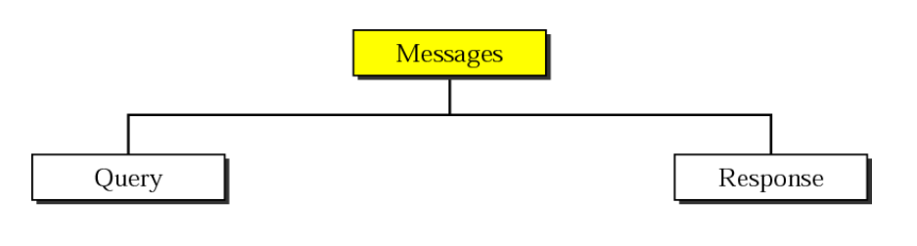
Các loại thông điệp trong quá trình truy vấn DNS
Thông điệp trong truy vấn DNS * Query *Response

Slide 6

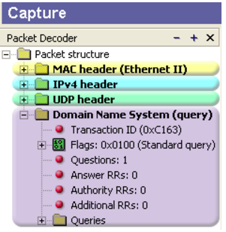
DNS QUERY MESSAGE
DNS Packet

Slide 7

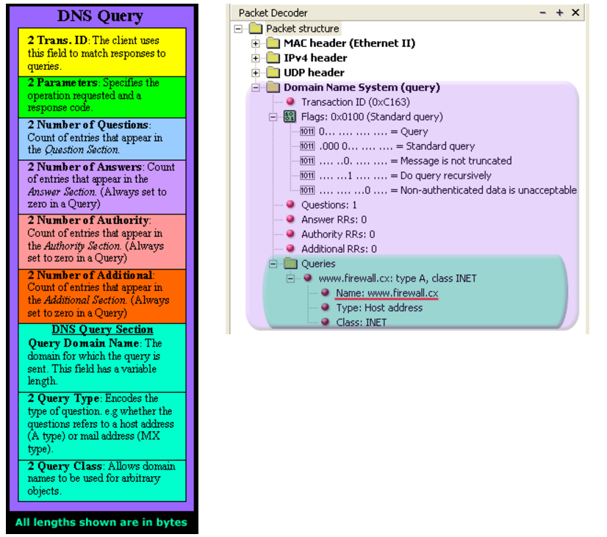

Slide 8
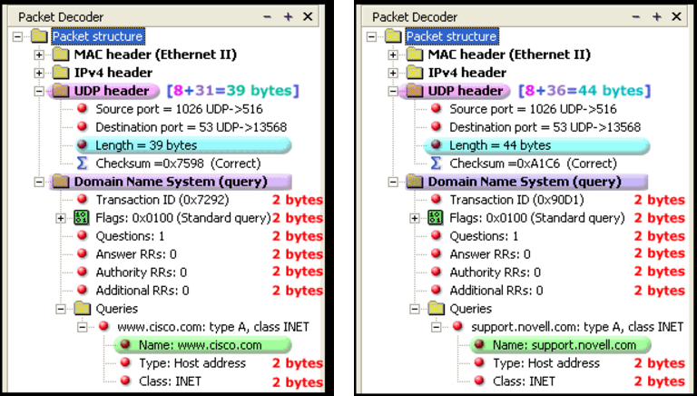
DNS NAME FIELD

Slide 9
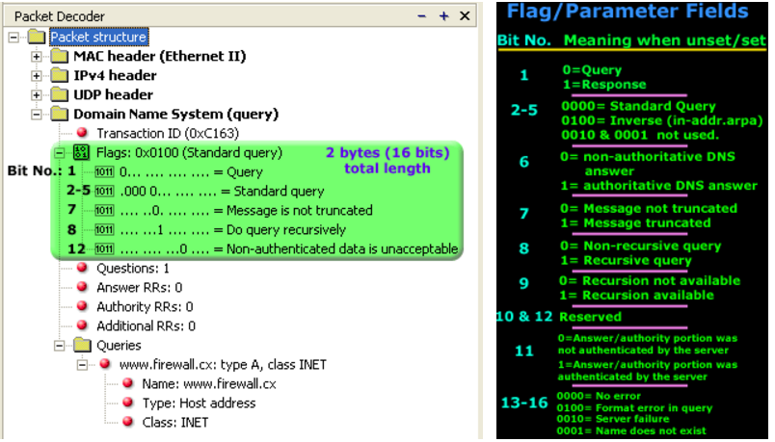
THE FLAGS

Slide 10

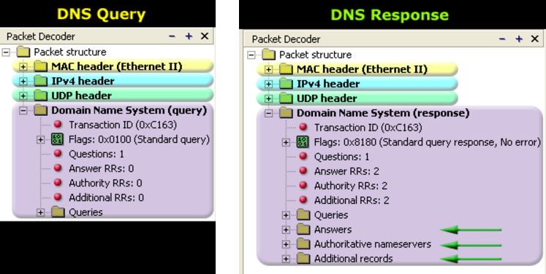
DNS RESPONSE MESSAGE
Different

Slide 11

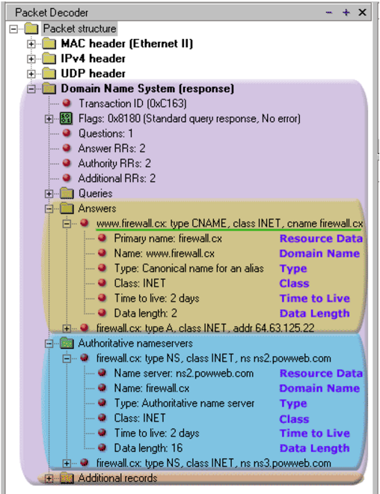

Slide 12
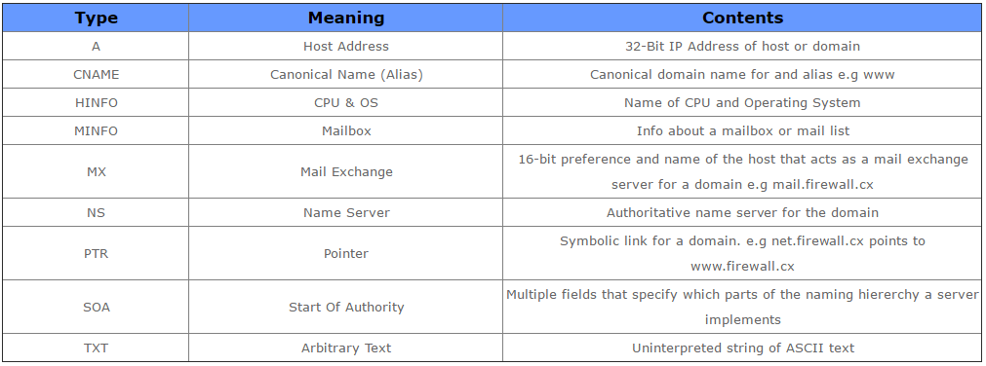
THE TYPE FIELD

Slide 13
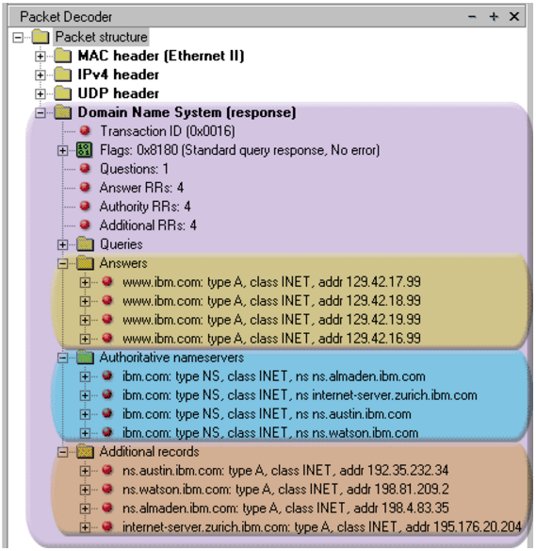

Slide 14
II. Xây dựng hệ thống DNS đơn giản
DNS Thread (main thread)
Port 53
MiniThread1
Gửi trả thông tin máy chủ cho client
Nếu là gói reverse
Client

Slide 15
Tạo
Auto Off Thread
Google
10. Google trả về
500ms
9. Không có
(Gửi cho goole)
Tạo
DNS Thread
Mở
Tìm trong database
Và trả về kết quả
Trả về
Database
Port 53
Mini Thread 1
Gửi gói
Kiểm tra (Gói request domain)
Trả gói response
Tạo gói response
Gửi yêu cầu
Client

Slide 16
Google DNS
.vn
.net
.com
Nếu không tìm thấy trong csdl
DB1
DB2
DB3
updateThread
Slave 1
Slave 2
Slave 3
Main Thread
Port 53
Mini thread1
Root Server
Mini thread
Main Thread
.com
.vn
.net
.com
Abc.com
Port 53
.com
Abc.com
Client
III. Hệ thống phân tán sử dụng DNS

Slide 17
Root Server
Sau mỗi 60s
Rebroadcast
Port 1995
Slave1 + Slave 3
Slave 1
Slave 2
Slave 3
Slave 3

Slide 18
Root Server
Sau mỗi 60s
Rebroadcast
Port 1995
Slave1 + Slave 3
Slave 1
Slave 2
Slave 3
Slave 3

Slide 19
Root Server
Sau mỗi 60s
Google
Rebroadcast
Port 1995
Slave 1
Slave1
Slave 2
Slave 3
Slave2
Slave 3

Slide 20
IV. Hệ thống phân tán sự dụng RMI
Mô hình tổng quan
Google DNS
Database
Root
.com
Slave
Google DNS
.net
.vn
Slave
Client
Slave

Slide 21
Xử lý phía route server
Broadcast tìm các máy slave server port 53
Config các slave: .com, .net, .vn
Gọi slave server
Kiểm tra trạng thái hoạt động của slave server
Root Server
MiniRMI Thread
Phân tích gói, tìm slave server phù hợp
Sử dụng phương thức gọi từ xa (RMI) để gửi
yêu cầu xử lý đến slave server
Client

Slide 22
Xử lý phía slave server
Database
Goolge DNS
MiniRMIDNS Thread
Client
Tiếp nhận yêu cầu
Main Thread
Slave Server

Slide 23
V. Vitual IP ( Hướng phát triển )
Round robin
Cả client và server sử dụng chung một mạng ip ảo
Linux : Piranha
Vitual IP
Window server 2012
Network load balancing
Server
Server
Server

Slide 24

Thank you for your time

